Slide 1
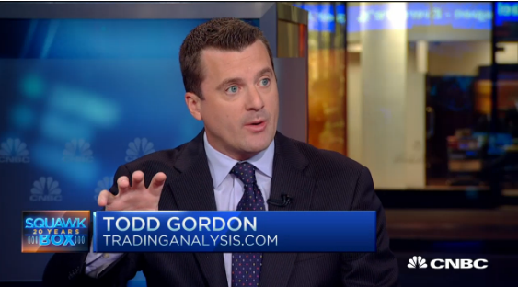
Optimizing Your Options Trades Using Elliott Wave and Fibonacci Live with Todd Gordon
May 17th, 2017 – 7:00 PM
PART 1
Elliott Wave

Slide 2
How To Get The Most Out of This Class
There are many questions circling in your minds right now, and I love it. We are biting into a pretty big task here of combining options, Elliott, AND Fibonacci into one class.
I love answering questions and responding to comments, but it’s possible I might not answer your question in chat. So, if I don’t acknowledge it, or skim through quickly, it’s likely we’ll be covering it shortly. I’m not ignoring you and trying to keep some semblance of a flow
The slides are numbered, so write down the slide number to ask me to go back.

Slide 3
How To Get The Most Out of This Class
Many eager trading minds out there, but be patient and listen!
This is being recorded, so no need to frantically write everything done. You’ll get the recordings, slides, notes, study guides, etc.
Instead, be content knowing you’ll probably pick up about 61.8% of the content presented to you, and you’ll re-watch to get the other 38.2% of the ideas.
Wait for the AHA moments. If you’re newer to options, there will be quite a few of them. If you’re more advanced in your trading career, there won’t be as many, but remember that last 20% can make 80% of the difference!
If you’re new to options, it might be a bit like drinking from a fire house, but I will monitor this questions and do more basic reviews for you after the live trading sessions.

Slide 4
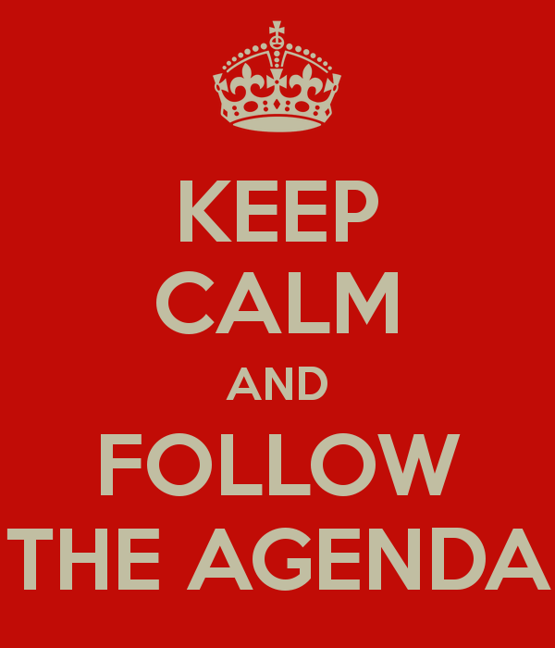
What’s On Today’s Agenda
First, we’re going to focus market trends and corrections as identified through the lens of Elliott and Fibonacci
Intro options and show you how they fit like a glove in the world of Elliott and Fibonacci.
We are going to learn to “spread the risk” in options to strive for consistency, while managing risk.
Using Elliott and Fib we’ll isolate the likely beginning and ending points of coming market moves to help you structure your option trades.
Decipher proper option structures to use in trending environment vs corrective environments. 4 key option setups to learn!

Slide 5
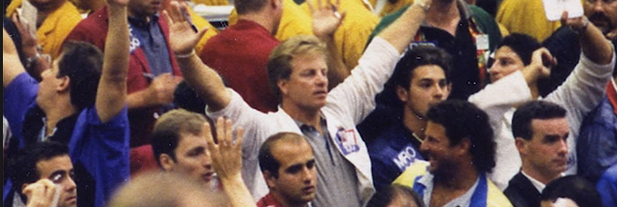
Anything Can Happen In The Markets
The markets like to pick on the smart people who “have it all figured out”
Those who pride themselves and like to show how smart they are often humbled by the markets.
Many times the toughest guys who have been humbled by life and know they’re not the smartest guy in the room excel in trading
Intestinal fortitude and the endurance to go a full 12 rounds to win the decision is what it takes to succeed in trading.

Slide 6
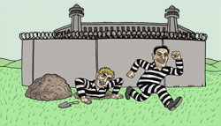
Let’s Get Started
TRADING
Directional vs Correctional

Slide 7
-Trading- Directional vs Correctional
If trading futures, stocks, or forex you’re forced to constantly search for the directional markets and stay away from the correctional markets
NOT the case when you overlay options on top of your trading
It’s true that the majority of your profits will likely be made in the directional markets, but with options you can supplement your trend trading activity by selling option premium in corrective markets.
Directional Trading
Correctional Trading

Slide 8
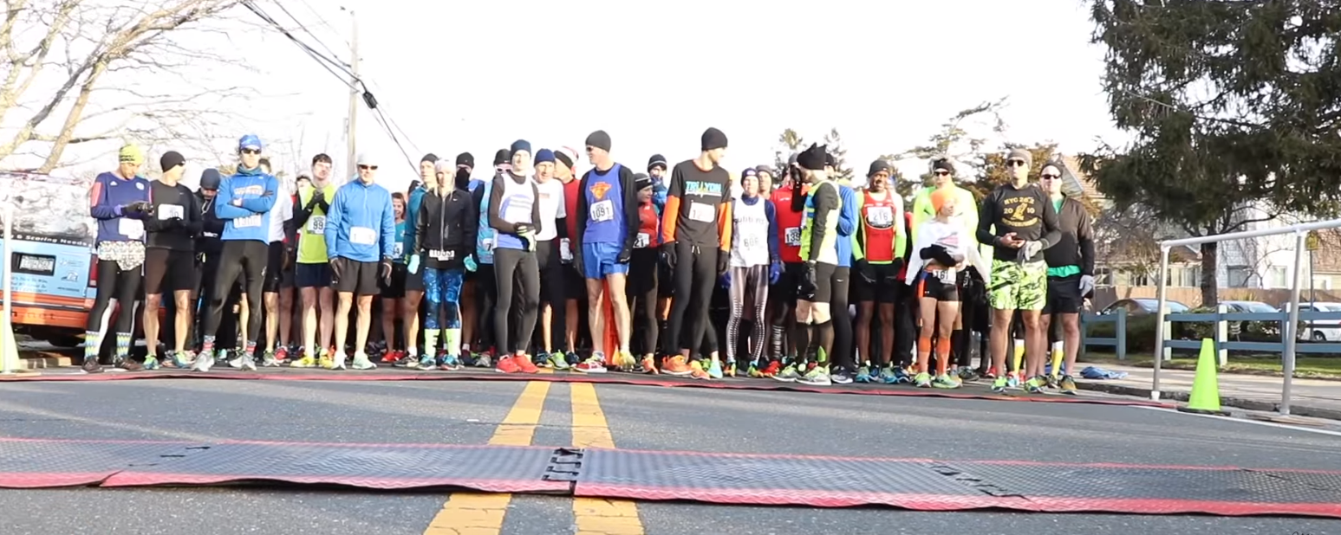
Let’s Get Started
The beginning trader treats each trade as an all-or-nothing event.
It’s not all or nothing. It’s not a sprint. It’s a marathon.
A trade is not a process of moving from point A to point B. It’s more like a meandering river through mountains and forests that may take you to your intended spot.
Be fluid in your trading, but have an intended direction.

Slide 11
Andrew Baptiste, Chief Technical Analyst at Morgan Stanley 1999-2011, 1992-2010 JP Morgan In essence, "The Wave Principle is a simple rule-based methodology (3 rules) that allows the practitioner to dissect the collective ‘mindset’ of the market’s participants, which allows for defined, attractive / positive Risk-Reward trading / investing parameters – A Game Plan.“
Paul Tudor Jones from the trading classic "Market Wizards" The reason he has been so successful is the Elliott Wave Theory allows one to create incredibly favorable risk/reward opportunities. That is the same reason I attribute a lot of my own success to the Elliott Wave approach.

Slide 12
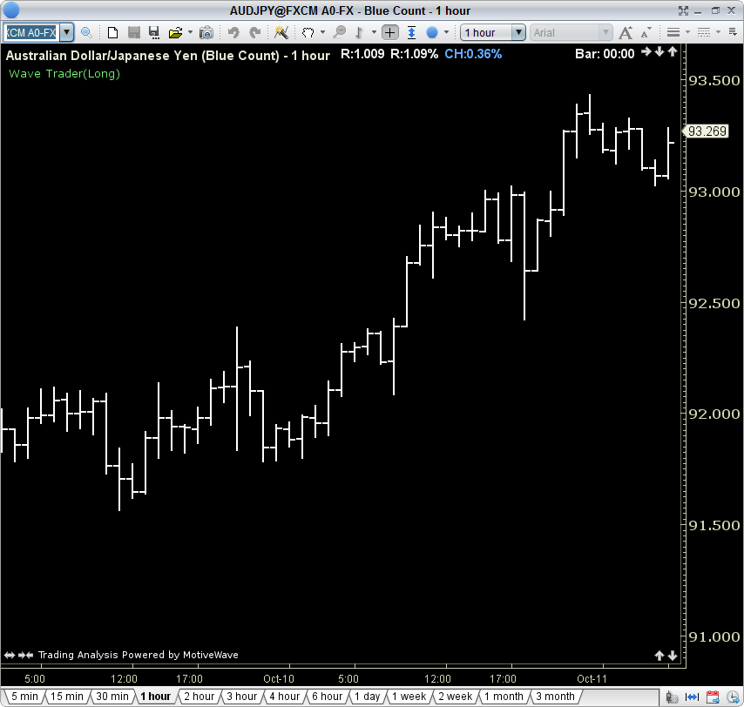
Wave 5
Basic Motive Wave
Wave 3
Wave 4
Wave 1
Wave 2

Slide 13
5
Wave 3
- Strong, deliberate, and extended price action
Fundamentals increasingly better
- Investor confidence greatly improved
3
Wave 1
- Fundamentals poor
- Investors fully, bearish
expecting new lows
Heavy short selling
1
4
Wave 2
Investors fully bearish, certain of new lows
- Heavily retraces W.1
- Fundamentals horrible, doom and gloom
Volumes light, as sellers dry up
2
The Motive Wave

Slide 14
5
Wave 5
- Investors extremely optimistic
Fundamentals return, but often not to W.3 levels
Price momentum less than W.3
3
1
4
Wave 4
Fundamentals temporarily peak, then pullback
Often shallow, yet prolonged consolidation
2
The Motive Wave

Slide 15
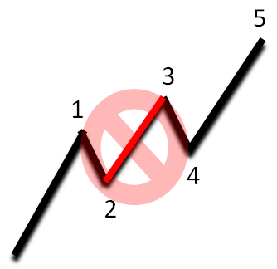
Basic 5-Wave Pattern
5
Rules of the 5-Wave Pattern
3
5
3
Wave 2 can NOT retrace to the
beginning (or beyond) of Wave 1.
1
4
1
2
4
2
Wave 4 should not touch Wave 2 and
CAN’T break below wave 2 low
Wave 3 is often the longest, but
it is never the shortest.

Slide 16
Multiple Degrees of a Trend
.5
Largest Degree
.3
5
5
3
Smallest Degree
B
3
1
4
.1
4
2
1
A
C
5
.4
3
B
1
2
4
A
C
2
.2

Slide 17
3 Degrees of a Trend
1
.5
.3
5
5
3
B
3
1
4
4
2
.1
1
A
C
5
.4
3
B
3 Degrees Of Trend
Largest: 1
Middle: .5
Smallest: 5
1
2
4
A
C
2
.2

Slide 18
3 Degrees of a Trend
1
.5
.3
5
5
3
B
3
1
4
4
2
.1
1
A
C
5
.4
3
B
3 Degrees Of Trend
Largest: 1
Middle: .5
Smallest: 5
1
2
4
A
C
2
.2

Slide 19
3 Degrees of a Trend
1
.5
.3
5
5
3
B
3
1
4
4
2
.1
1
A
C
5
.4
3
B
3 Degrees Of Trend
Largest: 1
Middle: .5
Smallest: 5
1
2
4
A
C
2
.2

Slide 20
3 Degrees of a Trend
1
.5
.3
5
5
3
B
3
1
4
4
2
.1
1
A
C
5
.4
3
B
3 Degrees Of Trend
Largest: 1
Middle: .5
Smallest: 5
1
2
4
A
C
2
.2

Slide 21
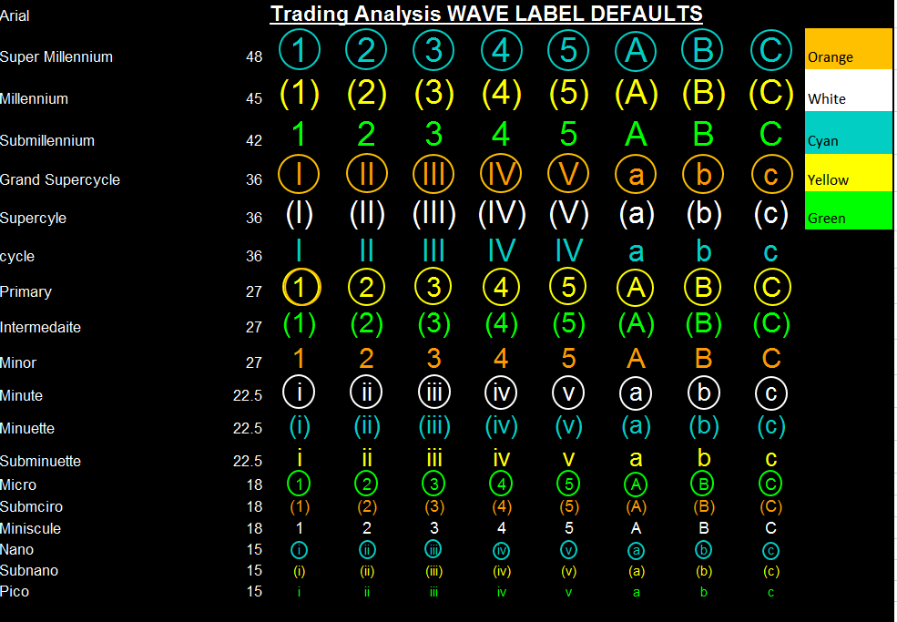
Wave Label Table

Slide 22
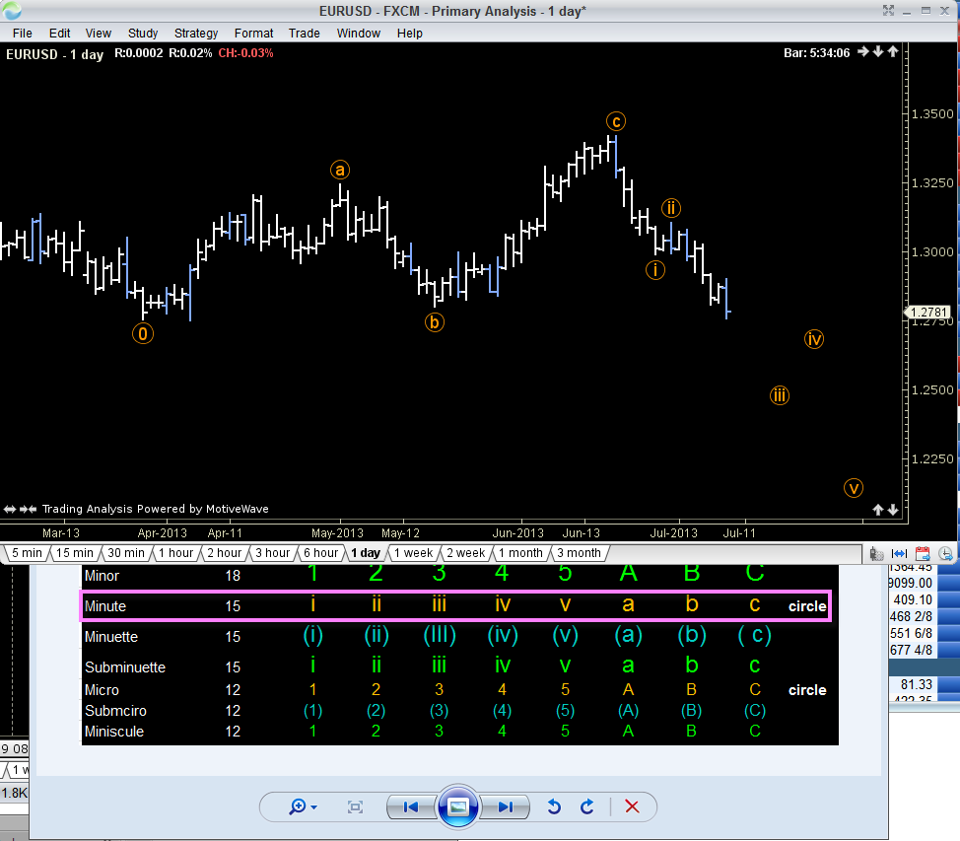
Drill Down The Table

Slide 23
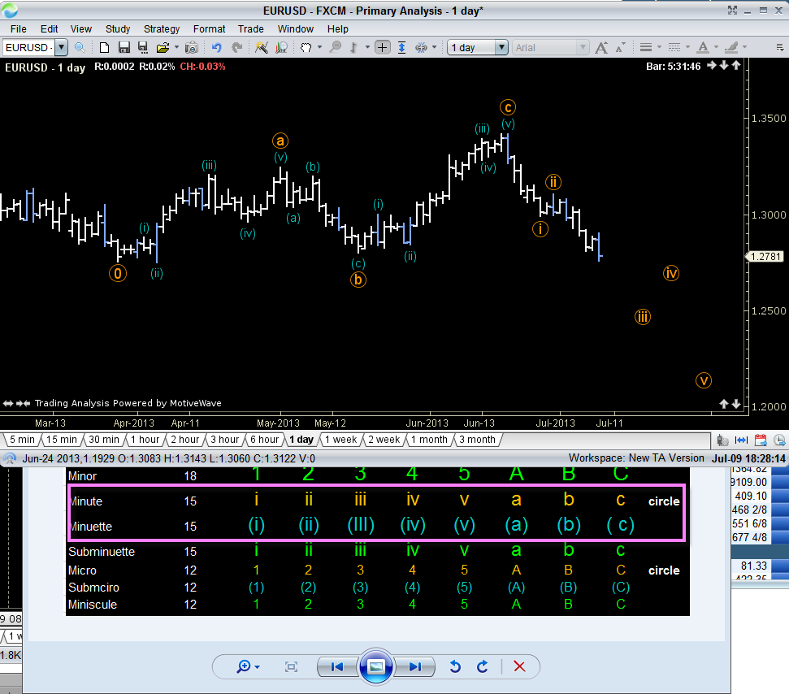
Drill Down The Table

Slide 24
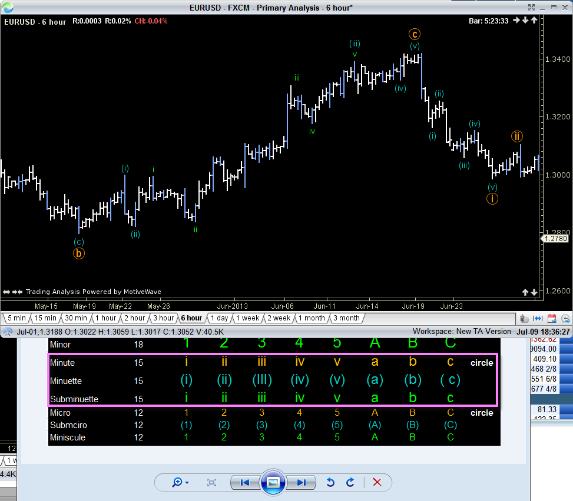
Drill Down The Table

Slide 25
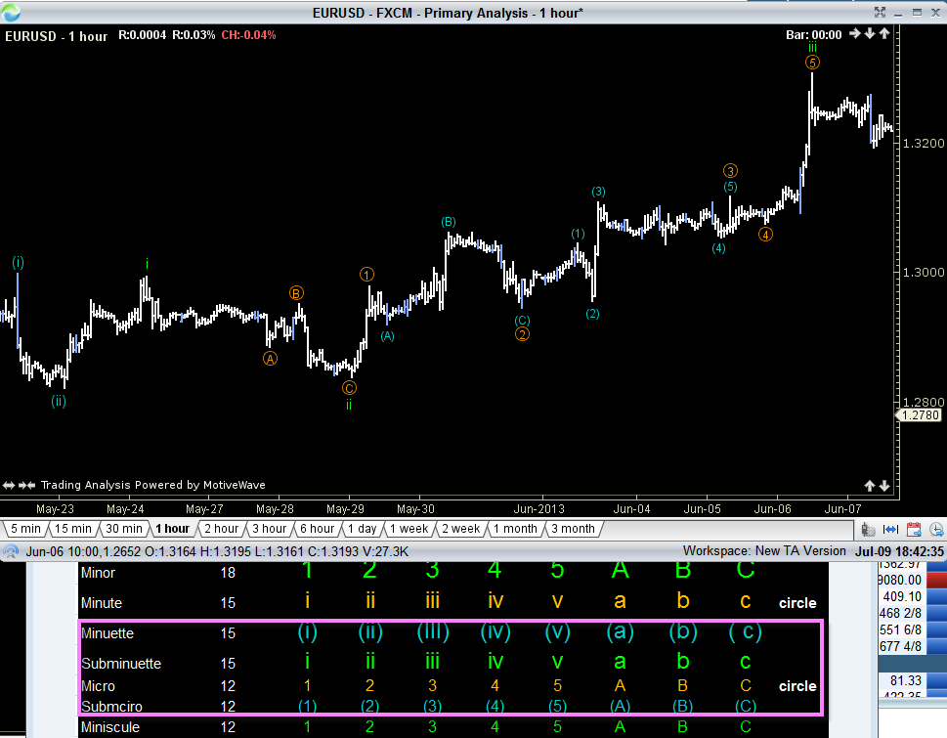
Drill Down The Table

Slide 26
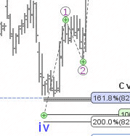
Let’s work UP the label table

Slide 27
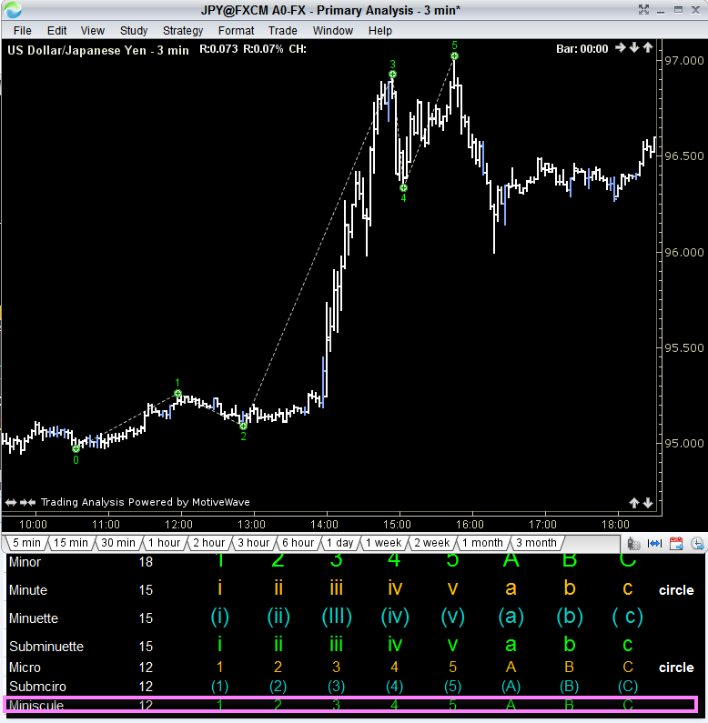
Count UP The Table

Slide 28
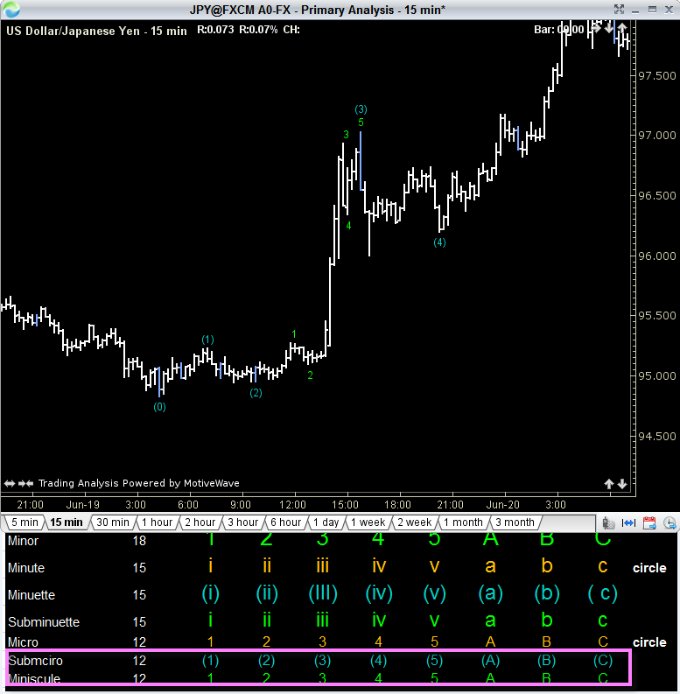
Count UP The Table

Slide 29
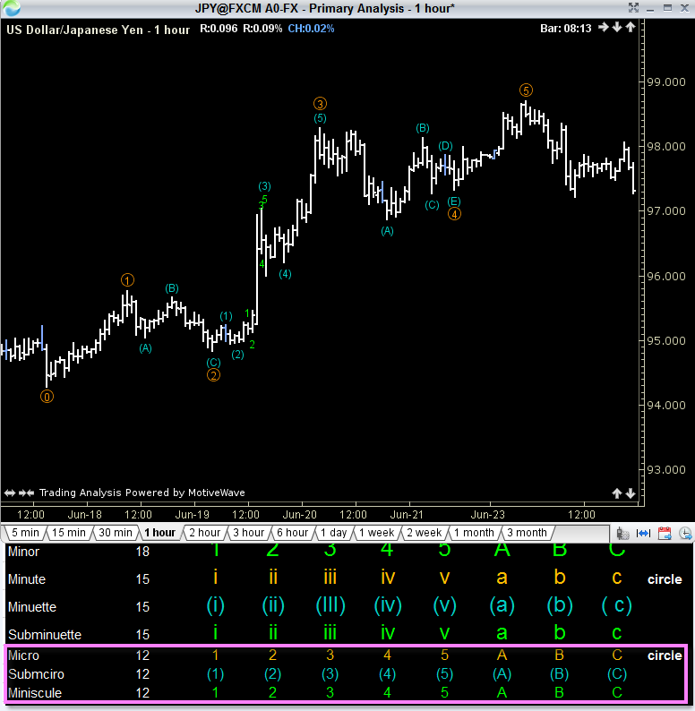
Count UP The Table

Slide 30
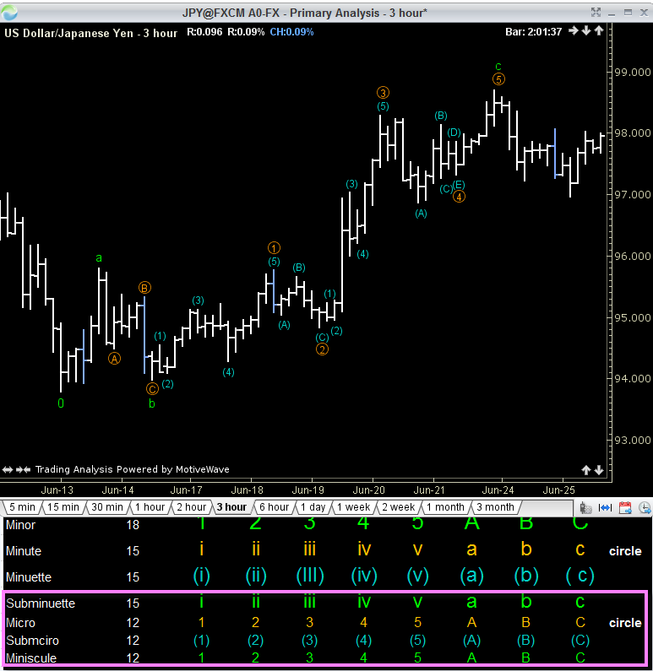
Count UP The Table

Slide 31
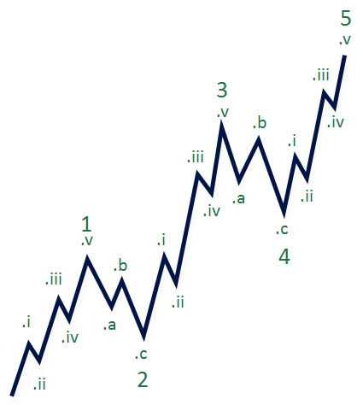
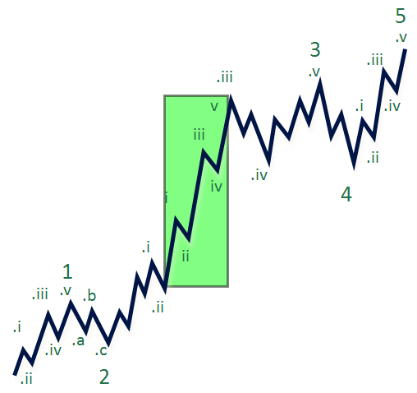
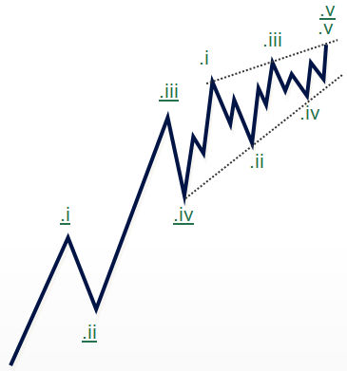
Motive Wave Variations
Impulse
Impulse Extension
Diagonal Triangles

Slide 32
Diagonal Triangles
Motive, yet NOT impulsive
.v
.v
.v
.iii
.iii
.i
.iii
.iv
.iv
.i
.ii
.v
.iii
.i
.iv
.i
.ii
.iv
.ii
.ii
Ending Diagonal
Leading Diagonal

Slide 33
Motive vs. Impulsive
What’s the difference?
.v
.iii
.v
.i
.iii
.i
.iv
.iv
.ii
.ii
Ending & Leading
Diagonal Motive Wave
Motive Impulsive Wave
Motive = 5 Wave Structure
Motive Impulsive = 5 Wave Structure + Follows Impulsive Rules
Tip : Wave 4 usually over laps into Wave 1 territory.

Slide 34
Ending Diagonal
1
Motive, yet not impulsive.
Occurs at termination points of
larger degree, exhaustive points.
5th -waves and C-waves
Subdivides into 3-3-3-3-3
Waves ii and iv should overlap
(c)
.v
.iii
.v
(a)
.i
.iii
.iv
.ii
.i
.iv
(b)
2
.ii

Slide 35
Leading Diagonal
.v
Subdivides into 5-3-5-3-5.
5-wave subdivisions convey continuation,
unlike 3-wave subdivision of ending
diagonals.
Occurs in W1 of impulse, or WA or
a Zig-Zag.
Contains converging trend lines.
Motive, yet not impulsive.
Waves .ii and .iv should overlap
.iii
.i
.iv
.v
.iii
.i
.ii
.iv
.ii

Slide 36
Corrective Waves
5
3
B
1
4
A
C
2
Uptrend
Downtrend

Slide 37
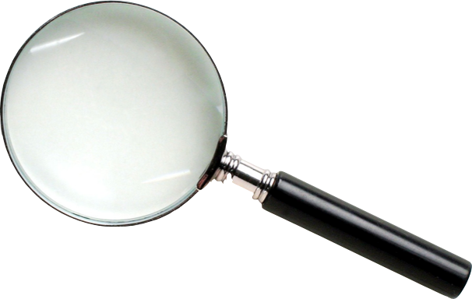
Variations of Corrective Waves
B
A
Zig-Zag
C

Slide 38
Zig-Zag Corrections
1. 3-Wave (ABC) structure
B
ii
iv
a
2. Counts as 5-3-5
i
ii
3. Often found in W.2 or W.B
iii
b
B-wave retraces less than 78.6% of A
The end of W.C is
considerably lower than the
start of W.A
i
iv
v
A
iii
v
C
(2) or (B)

Slide 39
Zig Zag
Wave A is often
equal to Wave C
in terms of price
distance traveled

Slide 40
Variations of Corrective Waves
B
A
C
Flat

Slide 41
Flat Corrections
(3)
B
3-wave pattern labeled A-B-C
c
b
Subdivides 3-3-5
a
ii
Often occurs in W.4
i
iv
a
b
Unlike Zig-Zags, the end of W.C terminates just prior, at, or beyond the end of W.A.
B-wave should retrace at least 90% of A
c
iii
A
v
C
(4)
Occurs in strongly trending
markets, around an extension

Slide 42
Expanded Flat Corrections
B
(3)
c
W.B ends beyond W.A’s
beginning
b
ii
a
W.C ends beyond W.A’ end
i
a
b
iv
Very common variation
Same composition as a
regular flat wave
c
A
iii
v
C
(4)

Slide 43
Flat Corrections
B
(3)
c
b
ii
Counts as 3-3-5
a
W.B ends beyond W.A’s
beginning
i
a
b
iv
W.C ends beyond W.A’s end
c
Very common variation
A
iii
v
C
(4)

Slide 44
FLAT CORRECTION

Slide 45
Lennar Wave 2 Flat

Slide 49
Variations of Corrective Waves
B
D
E
A
C
Triangle

Slide 50
Triangle Corrections
(3) or (A)
(5) or (C)
Reflects balance of forces
B
D
Occurs prior to a final motive
wave in the pattern of one
larger degree, terminal move
E
5 waves, all with 3-wave
subdivisions, labeled
A-B-C-D-E
C
(4) or (B)
A
Must retrace portion of the
prior impulse wave at W.E’s end

Slide 51
Running Triangles
B
(5) or (C)
(3) or (A)
W.B exceeds W.A’s beginning
D
Advance to new high in W.B
often ‘fakes’ traders out
E
C
(4) or (B)
Very common variation
A

Slide 52
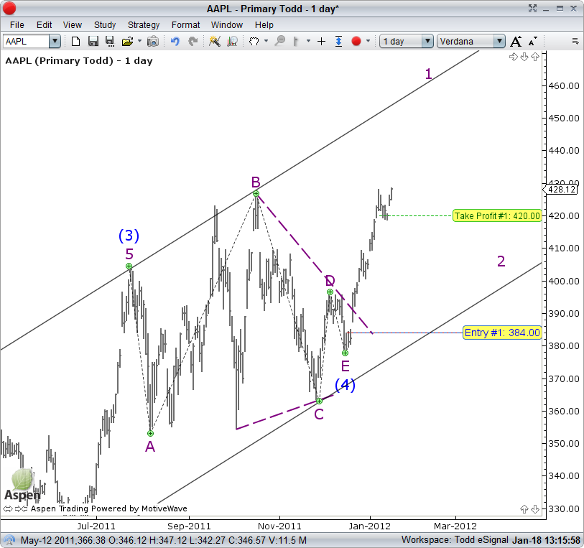
Running Triangles

Slide 53
Variations of Corrective Waves
X
Y
W
Combination

Slide 54
X-Wave Combinations
B
B
ii
ii
c
Instead of an A-B-C pattern,
combinations take on an
W-X-Y pattern
c
iv
X
iv
a
a
(X)
ii
(X)
ii
B
i
B
i
ii
ii
c
c
b
iii
b
iii
i
i
iv
X waves are typically a
Zig-Zag pattern
iv
a
iv
a
iv
ii
i
ii
v
i
v
A
A
b
iii
b
iii
iii
iii
i
i
iv
iv
W & Y waves are either
Zig-Zags, Flats or Triangles
v
v
v
v
W
C
C
A
A
iii
iii
(W)
(W)
C
C
Combinations typically have
a side-ways appearance
Y
(Y)
(Y)

Slide 55
Double Zig-Zag Combo
B
ii
c
iv
a
(X)
i
ii
B
ii
c
iii
b
i
iv
iv
a
ii
v
i
A
b
iii
iii
i
iv
v
v
C
A
iii
(W)
C
(Y)
A Double Zig-Zag joined by a X wave which is also a Zig-Zag
This would be a very deep correction compared to other combinations

Slide 56
Flat Triangle Combo
Flat Wave
Triangle
(X)
(Y)
(W)
Flat Waves are common in the W wave position
Triangles are common in the Y wave position
This combination looks more sideways than directional

Slide 57
Flat Zig-Zag Combo
Flat Wave
(X)
Zig-Zag
(W)
(Y)

Slide 58
Triple Combination!
Zig-Zag
(X)
Flat
(X)
Triangle
(W)
(Z)
(Y)
Triple combinations are three corrective patterns joined by two X waves.
Labeled W-Y-Z (W-X-Y-X-Z). Rare.

Slide 59
Fibonacci Tool #1
Retracements

Slide 60
Fibonacci Retracements
Retracements ratio’s are
used to analyze
corrective Waves
38.2%
…. by measuring
previous trend waves
61.8%
100%
100%

Slide 61
Applying Fib To Trend Waves
Fib retracements study the on-going trend wave and provide an area that a future corrective wave could occupy.
Primary retracements
38%
50%
61.8%
78.6%
Minor retracements
23.6%
70.7%

Slide 62
Fibonacci Tool #2
Extensions

Slide 63
External Retracements
127.2%
261%
Ext. Ret. ratio’s are
used to analyze trend
waves
…. by measuring
previous corrective
waves.

Slide 64
External Retracements
Key Ratios
127.2 %
161.8 %
200.0 %
261.8 %
423.6%
Helps determine the completion of a trend wave
Serves as potential Exit levels for trades in the direction of the larger trend
Serves as potential entry for contra-trend trades

Slide 65
External Retracements
2.00
1.618
Extensions for Exit
Identify a completed
correction & anticipate a
new trend wave
1.272
1.00
0.618
Measure corrective wave
to define extension levels
0.000
Watch for the end of
correction for entry

Slide 66
Applying Fib To Corrective Waves - Extensions
Fib extensions study the on-going corrective wave and provide an area that a future could trend wave occupy.
Primary extensions
127.2%
161.8%
200%
261.8%

Slide 67
Fibonacci Tool #3
Projections

Slide 68
Fibonacci Projections
200%
Projections are
used to measure trend
waves
…. by measuring
previous trend &
corrective waves.

Slide 69
Fibonacci Projections
Key Ratios
38.2 %
61.8 %
100.0 %
127.2%
161.8 %
200.0 %
261.8 %
423.6%
Helps determine the completion of a trend wave (W.1,3,5,A or C).
Serves as potential Exit levels for trades in the direction of the larger trend, or entry levels against the trend.
Serves as potential entry on counter-trend trades

Slide 70
Fibonacci projections
1.618
projections for Exit
Identify a completed
trend & Correction &
anticipate a new 5-wave
trend.
1.000
0.618
5
Click 2
3
B
Measure (click) the 3
end points of the trend
& Corrective Wave.
Click 3
0.000
1
4
A
C
Watch for the end of
the trend wave at
projections ratios for exit.
2
Click 1

